Slide 1
A Comparative Study of Classification Algorithms
Team 1
Narendra Singh Bisht
(AM.EN.P2ARI20043)
Urvi Sharma
(AM.EN.P2ARI20022)

Slide 2
Overview
Problem Statement
Motivation: Why Classification?
Reviewed Algorithms
Logistic Regression
Linear Discriminant Analysis (LDA)
Support Vector Machine (SVM)
K-Nearest Neighbors (KNN)
Naïve Bayes
Decision Tree
Random Forest
Evaluation Metrics
Explored Applications
Observations
Conclusion

Slide 3
Problem Statement
To implement and analyze common classification algorithms, such as Logistic Regression, Linear Discriminant Analysis (LDA), Support Vector Machines (SVM), K-Nearest Neighbors (KNN), Naïve Bayes Classifier, Decision Trees and Random Forest for a given dataset.
Applications-
Heart Disease Detection,
Iris Flower Species Identification,
Loan Eligibility Prediction,
Twitter Sentiment Analysis

Slide 4
Motivation: Why Classification?
Classification is an important aspect in supervised machine learning. There are several machine learning models out there, and most of them use classification algorithms.
A common job of machine learning algorithms is to recognize objects and being able to separate them into categories.
It is used in several machine learning applications such as, Image Classification, Spam Filtering, Medical Diagnosis, Loan Prediction, Sentiment Analysis etc.

Slide 5
Reviewed Algorithms
Logistic Regression​
Linear Discriminant Analysis (LDA)​
Support Vector Machines (SVM)​
K-Nearest Neighbors (KNN)​
Naive Bayes Classifier​
Decision Trees​
Random Forest​

Slide 6
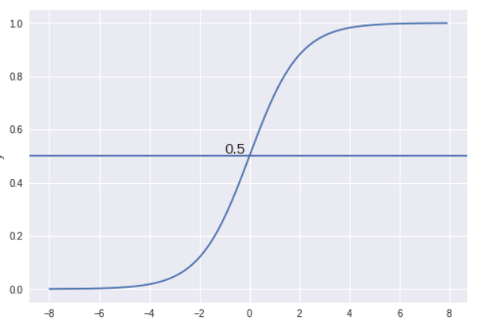
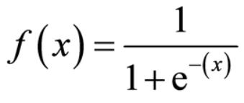
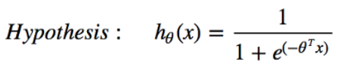
Logistic Regression
Sigmoid Function
The hypothesis of logistic regression limits the predicted value between 0 and 1.​

Slide 7
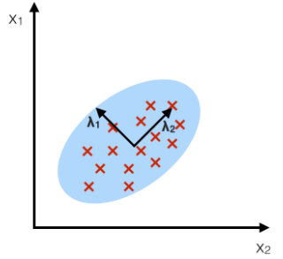
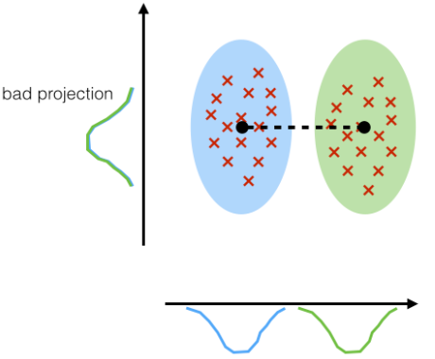
Linear Discriminant Analysis (LDA)
LDA:
Component Axes that maximize the class separation
Linear discriminant analysis is used as a tool for classification, dimension reduction, and data visualization.
Goal is to maximize the interclass mean separation and minimize intra-class co-variance.
PCA:
Component Axis that maximize the variance.
Source: sebastianraschka.com

Slide 8
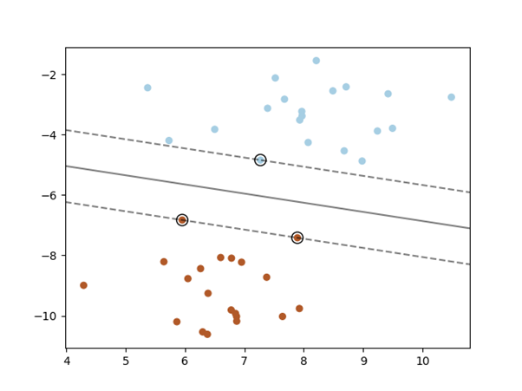
Support Vector Machine (SVM)
A support vector machine constructs a hyper-plane which can be used for classification.
Intuitively, a good separation is achieved by the hyper-plane that has the largest distance to the nearest training data points of any class (so-called functional margin), since in general the larger the margin the lower the generalization error of the classifier.
Source: https://scikit-learn.org/stable/modules/svm.html

Slide 9
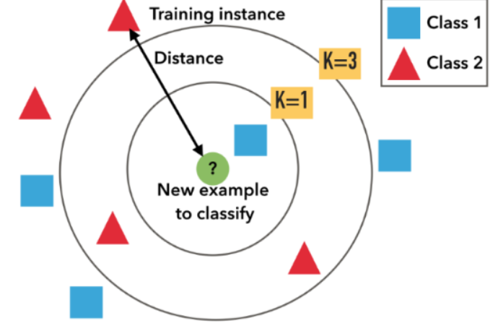
K-Nearest Neighbors (KNN)
Classifier implementing the
k-nearest- neighbors vote.
Searching through the entire training set for the K most similar instances (the neighbors) and summarizing the output variable for those K instances.
Source: https://medium.com/

Slide 10


Naive Bayes Classifier
It is a classification technique based on Bayes’ Theorem with an assumption of independence among predictors.
Two main types:
Gaussian Naïve Bayes
Multinomial Naïve Bayes
P(A|B) : the conditional probability that event A occurs , given that B has occurred. This is also known as the posterior probability.​
P(A) and P(B) : probability of A and B without regard of each other.​
P(B|A) : the conditional probability that event B occurs , given that A has occurred.​
Source: https://www.wikipedia.org/

Slide 11
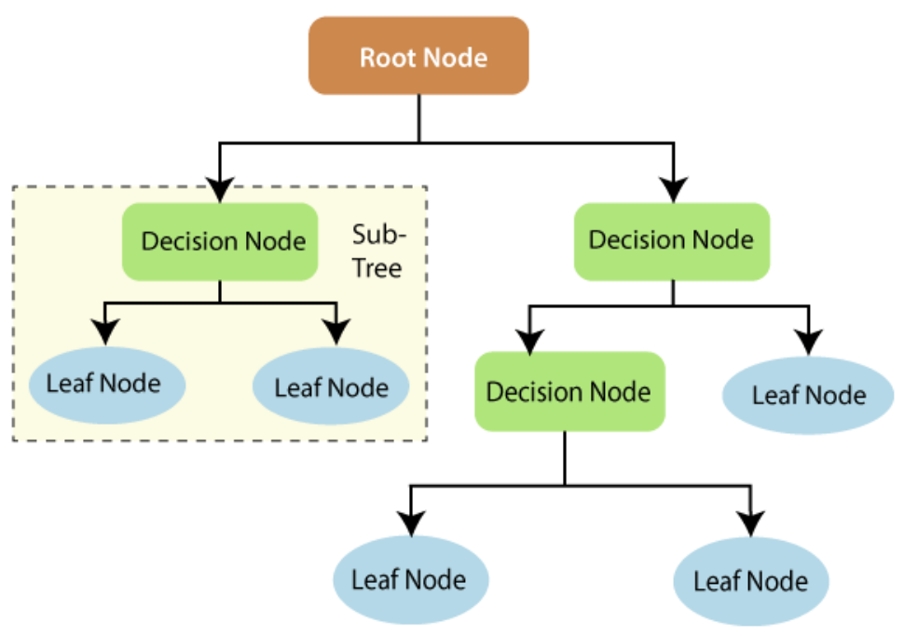
Decision Tree Classifier
The main entities of a decision tree are the decision nodes and the leaves. The decision nodes are the ones where the data gets fragmented, whereas the leaves are one where we get the output.
Source: javatpoint.com

Slide 12
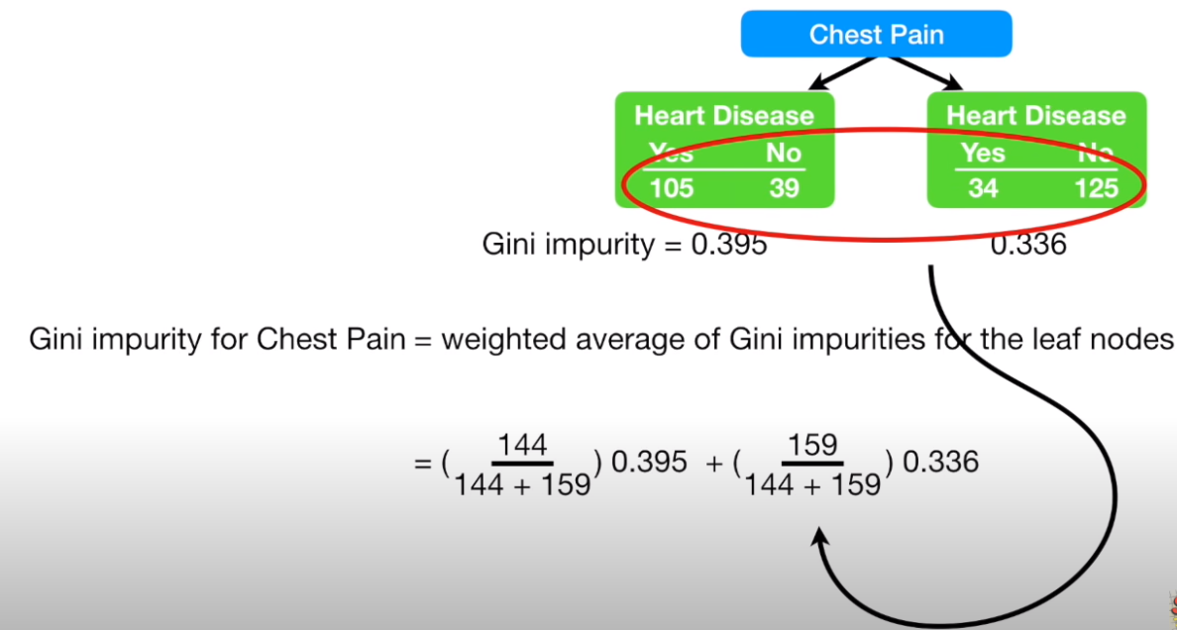
Gini Index (Example)
Source: statquest

Slide 13
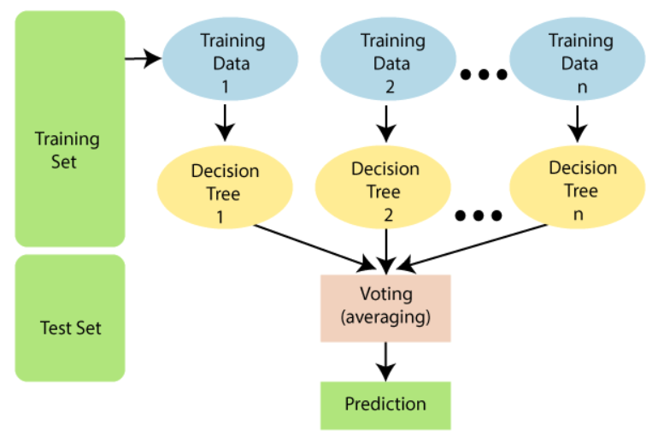
Random Forest Classifier
Random Forest is a classifier that contains a number of decision trees on various subsets of the given dataset and takes the average to improve the predictive accuracy of that dataset.
Instead of relying on one decision tree, the random forest takes the prediction from each tree and based on the majority votes of predictions, and it predicts the final output.
Source: javatpoint.com

Slide 14
Algorithm | Supervised/ Unsupervised | Linear/ Non-linear | Discriminative/ Generative | Sensitive to Outliers? | Parametric / Non-parametric | X₀ = 1 Yes/No | High Bias/ Low Bias | High Variance/ Low Variance | Is Normalization mandatory? | Assumes features are highly correlated?
LR | Supervised | Linear | Discriminative | Yes | Parametric | Yes | High Bias | Low Variance | Yes | Yes
LDA | Supervised | Linear | Generative | Yes | Parametric | Yes | High Bias | Low Variance | Yes | Yes
SVM | Supervised | Both | Discriminative | Yes | Non- Parametric | No | None | None | No | No
KNN | Supervised | Non-linear | Discriminative | Yes | Non- Parametric | No | None | None | No | No
NB | Supervised | Both | Generative | Yes | Both | No | None | None | Both | Both
Decision Tree | Supervised | Non-linear | Discriminative | No | Non-parametric | No | Low Bias | High Variance | No | No
Random Forest | Supervised | Non-linear | Discriminative | No | Non- Parametric | No | None | None | No | No

Slide 15
Explored Applications GitHub Repo: Click Here
Heart Disease Detection Deployed App: Click here
Iris Flower Species Identification Deployed App: Click here
Loan Eligibility Prediction Deployed App: Click here
Twitter Sentiment Analysis

Slide 16

Evaluation

Slide 17
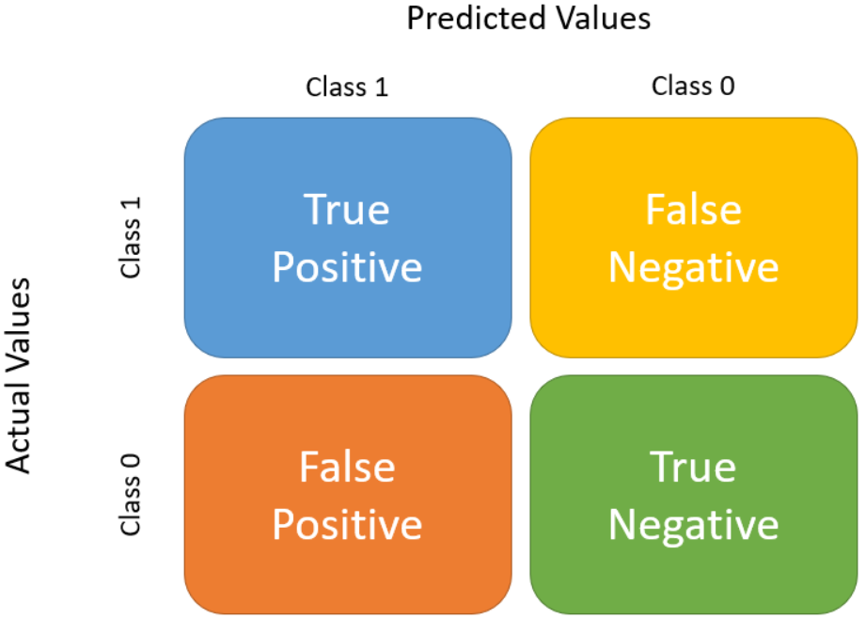
Confusion Matrix
Source: https://ailearnerhub.com/

Slide 18


Evaluation Metric
Accuracy is the proportion of predictions our model got right.
TP + TN / TP + TN + FP + FN
Precision is the proportion of predicted positive records that are actually positive.
TP / TP + FP
Recall is the proportion of positive records predicted correctly.
TP/TP+ FN

Slide 19
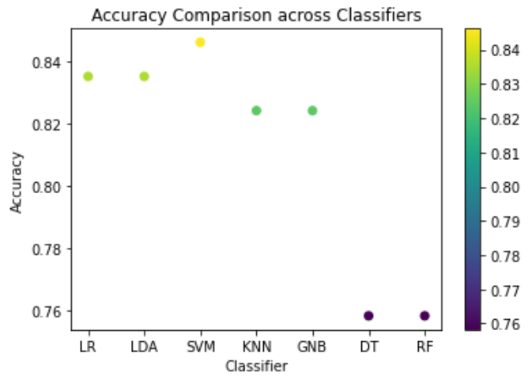
Heart Disease Detection
Observations

Slide 20
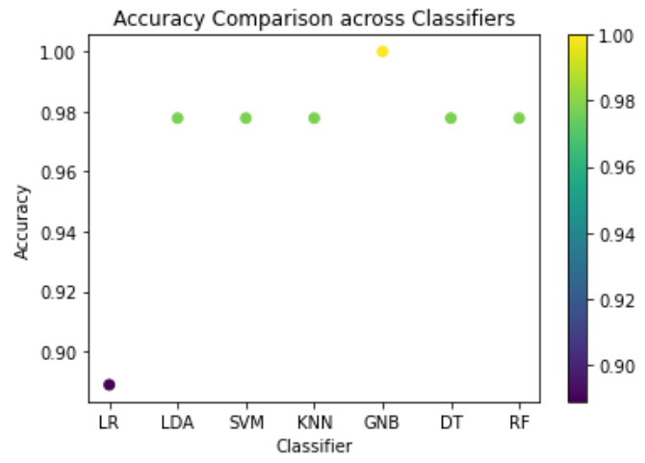
Iris Flower Species Identification
Observations

Slide 21
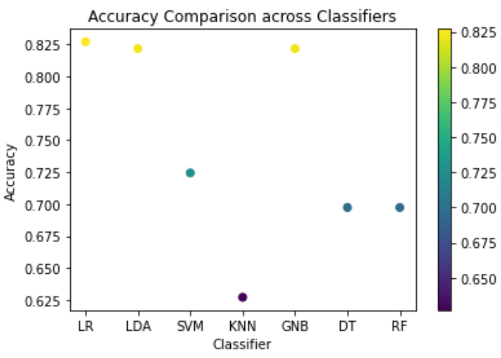
Loan Eligibility Prediction
Observations

Slide 22
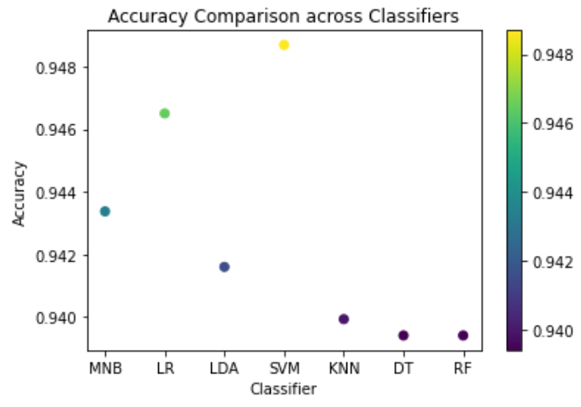
Twitter Sentiment Analysis
Observations

Slide 23
Best Classifier (based on Accuracy):
Heart Disease Detection SVM
Iris Flower Species Identification Gaussian Naïve Bayes
Loan Eligibility Prediction
Logistic Regression
Twitter Sentiment Analysis Support Vector Machine
Conclusion

